Slide 1
Parasites
http://animalscience.unl.edu/ffa-veterinary-science-contest-parasites (link may help)
PEER Program,
Texas A&M University

Slide 2
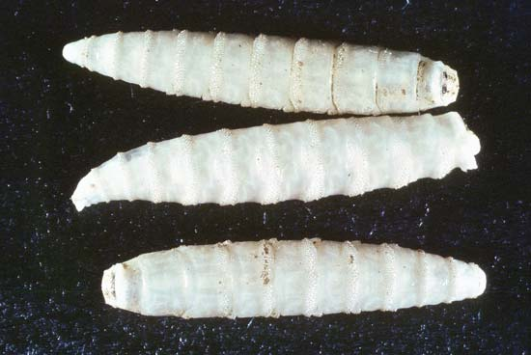
Blowfly (family Calliphoridae)
“Screwworm” (North and South American blowfly larvae)
Adult blowfly (bluebottle fly)

Slide 3
Blowfly
Characterized as metallic blue, green, or black in color
The larvae (maggots) feed on dung or the decaying flesh of dead animals
The larvae of some species infest open wounds of animals and sometimes humans
Often a problem in the livestock industry

Slide 4
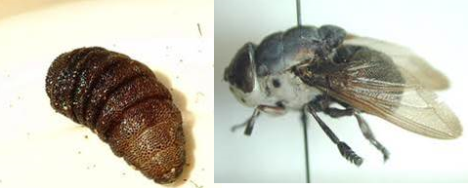
Cat Warble (Genus Cuterebra)
Larvae and adult fly
larvae

Slide 5
Cat Warble
Also known as a botfly maggot
The maggots crawl on the skin of passing animals and enter into the tissue via an orifice (ex: mouth, nasal passage, or external wound)
Migrate through tissues to the skin where they create a warble (a small lump in the skin)
Most found burrowed around the animal’s face or neck

Slide 6
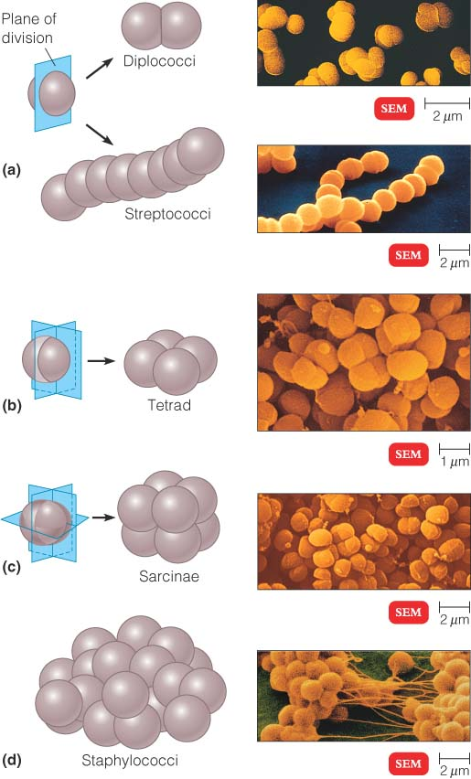
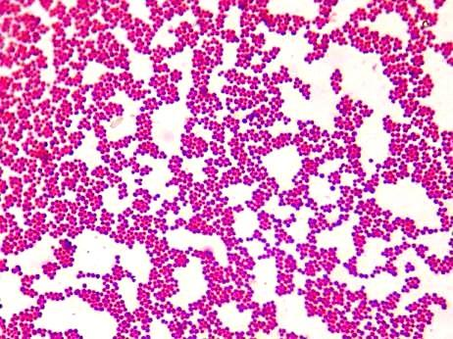
Cocci (bacteria)
Any bacterium that is spherical or has a generally round shape
Various shape arrangements
View under microscope

Slide 7
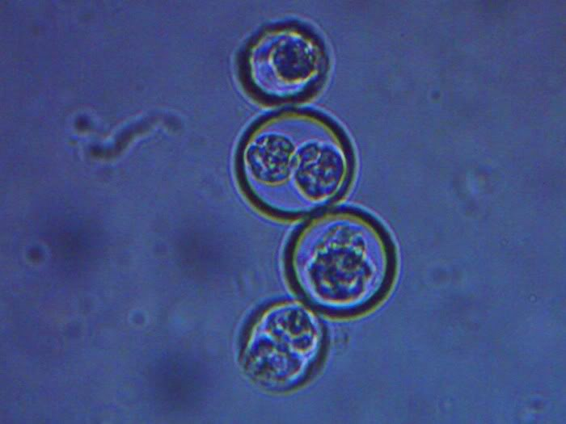
Coccidia (Genus Isospora or Eimeria)

Slide 8
Coccidia
Microscopic intestinal parasites of dogs and cats
Typically characterized by a round oval shape, with one to multiple sporocysts in their center
Rapid multiplication of the parasite in the intestinal wall causes the cells of the intestinal lining to rupture
They cause disease most commonly in puppies and kittens less than six months old, or in adult animals with a weakened immune system

Slide 9
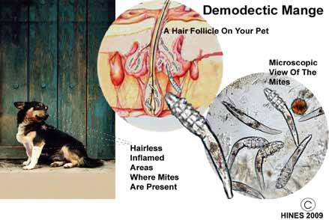
Demodectic Mite (Genus Demodex)
location of the mites
view under microscope

Slide 10
Demodectic Mite
A minute arachnid that can overpopulate hair follicles to cause mange and hairlessness
In severe cases, the mites multiply to the point where the body triggers irritation, inflammation, and stimulation of gland secretions
Typically affects dogs and cats (not contagious between animals, or to humans)

Slide 11
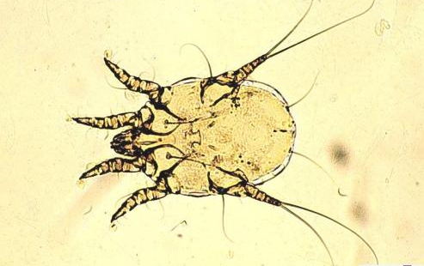
Ear Mite (Family Psoroptidae; Genus Otodectes)

Slide 12
Ear Mite
A surface mite that is typically found in the ear canal of some mammals
Microscopic in size
Highly contagious from animal to animal
Lives on cats and dogs (as well as has been found on foxes, ferrets, rabbits)

Slide 13
Flea Tapeworm Life Cycle* (includes the next five listed parasites)
Tapeworm segments full of egg capsules are shed through the animal’s feces
The egg capsules are ingested by flea larvae, where the eggs hatch and begin to mature inside the larvae
When the larval flea cocoons and becomes an adult flea, the tapeworm embryos in the flea mature to an intermediate stage
The infested flea is ingested by the animal (who is typically biting at an itchy spot)
The tapeworm develops into a full adult in the animal’s small intestines as the flea is digested, and attaches to the intestinal lining where it feeds on the animal’s tissue
The tapeworm fully matures and begins to shed segments (full of tapeworm egg capsules) off of its body, which end up in the animal’s feces, repeating the cycle
Further explanation of the life cycle at:
http://www.pet-informed-veterinary-advice-online.com/tapeworm-life-cycle.html

Slide 14
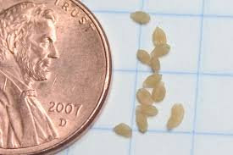
Flea Tapeworm Segment* (Genus Dipylidium)
Size comparison of tapeworm segments
Segments (right) compared to sesame seeds (left)

Slide 15
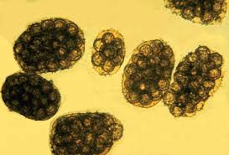
Flea Tapeworm Egg* (Genus Dipylidium)
Various views under microscope
Multiple tapeworm eggs enclosed in a capsule

Slide 16
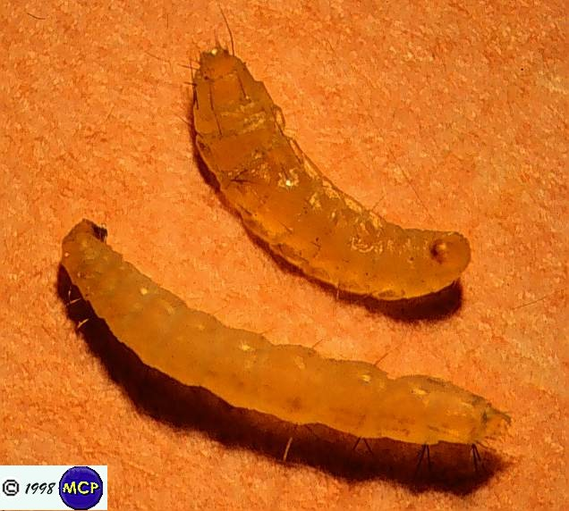
Flea Larva (Genus Ctenocephalides)
Larva under microscope
Larvae on skin

Slide 17
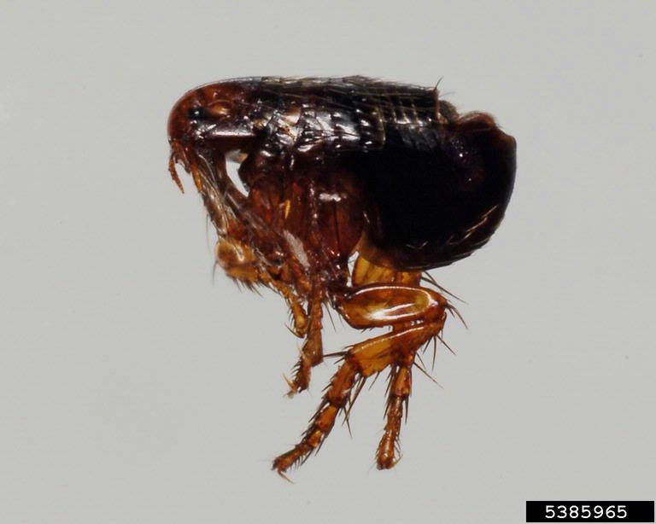
Fleas* (Genus Ctenophalides)

Slide 18
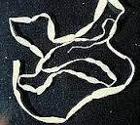
Flea Tapeworm* (Genus Dipylidum)
Adult tapeworm
Tapeworm starting to produce segments

Slide 19
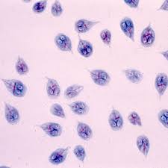
Giardia* (Genus Giardia)
Views from under microscope

Slide 20
Giardia*
Single-celled organism
Infects older animals more often than younger
Only a portion of infected exhibit symptoms
Life Cycle:
Animal ingests giardia cyst and become infected
Cyst becomes trophozoite form in small intestine, where it multiplies and feeds
Exits body through feces (only cysts can survive outside of the host)

Slide 21
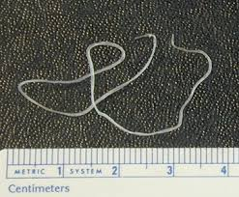
Heartworm* (Genus Dirofilaria)
Adult worm
Heartworm microfilaria under the microscope (blood smear)

Slide 22
Heartworm Life Cycle*

Slide 23
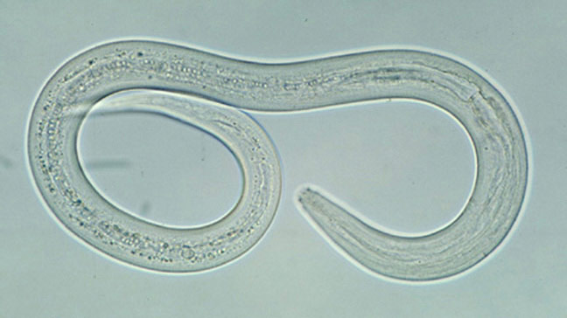
Hookworm* (Family Ancylostomatidae; Genus Ancylostoma, Uncinaria, Bunostomum, or Globocephalus)

Slide 24
Hookworm Life Cycle*
abc

Slide 25
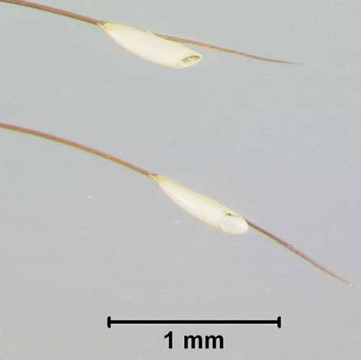
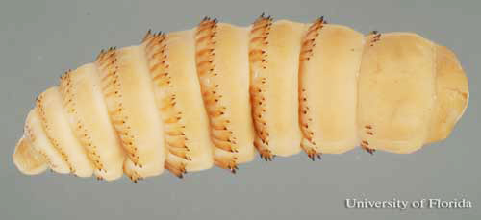
Horse Bots* (Genus Gasterophilus)
eggs
larvae
Bot fly

Slide 26
Horse Bots Life Cycle*
abc

Slide 27
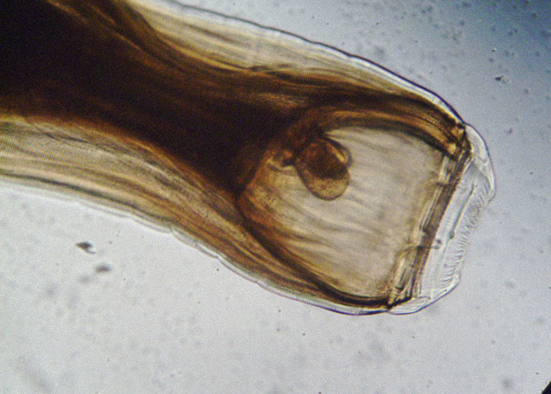
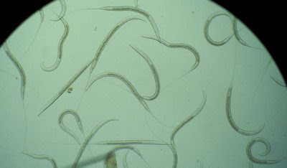
Horse Strongyles* (Family Strongylidae; Genus Strongylus)
eggs
adult
larvae

Slide 28
Horse Strongyles Life Cycle*
abc

Slide 29
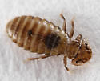
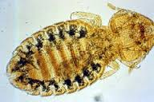
Lice – Biting (Order Mallophaga; Genus Bovicola or Trichodectes)

Slide 30
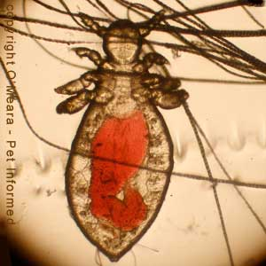
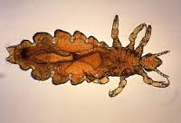
Lice – Sucking (Order Anoplura; Genus Linognathus or Hematopinus)

Slide 31
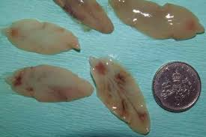
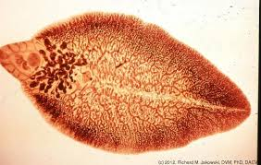
Liver Fluke (Class Trematoda; Genus Fasciola, Fascioloides, or Dicrocoelium)

Slide 32
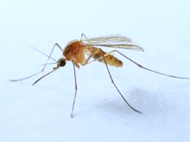
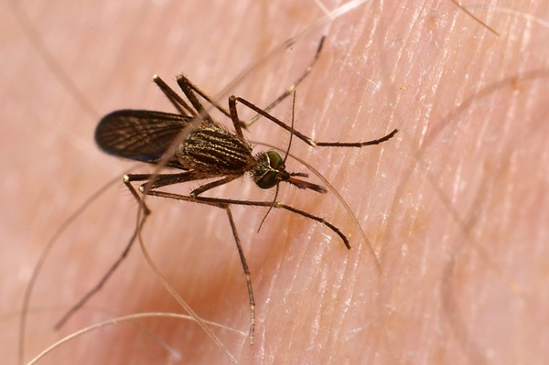
Mosquito Adult (Family Culicidae; Genus Anopheles, Culex, or Aedes)

Slide 33
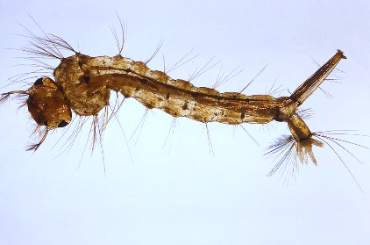
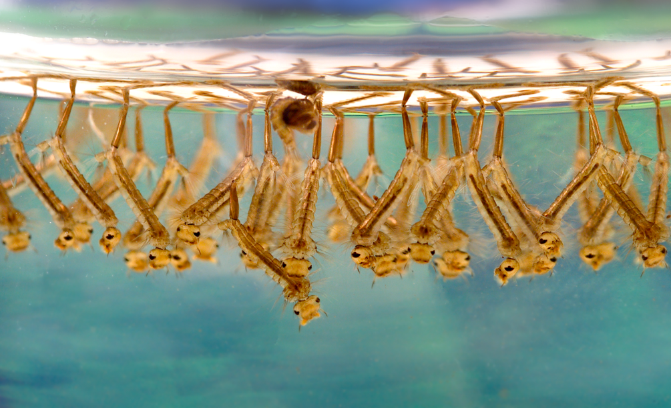
Mosquito Larva (Family Culicidae; Genus Anopheles, Culex, or Aedes)

Slide 34
Roundworm (Family Ascarididae or Toxicaridae;

